Slide 1


CRAFTIFY
ANJANA GOPAN K PROJECT GUIDE
ROLL NO : 08 HUSAIN AHAMED

Slide 2
PROBLEM STATEMENT
The project work entitled, “CRAFTIFY” is an Ecommerce Business Application to support sellers and customers for selling and buying of craft products as well as the accessories.
The Proposed System promotes tutors for online teaching of making crafts. It also provides an opportunity for an online photo exhibition. Tutorials will be provided free for 7 days, continue to access the tutorials only after subscribe the applications
The existing system is not efficient, and no opportunities for online tutors. There is no option for an online photo exhibition

Slide 3
OBJECTIVES
The main objective of the system is that all process is online. The system gives more interaction between sellers and customers which helps to improve quality of service
It manages the smooth working of a craft shop. It reduces the effort and time wastage of customers. It provides an online photo exhibition.
It provides personal login for the registered customers, sellers and tutors. It also sells craft accessories.

Slide 4
FUNCTIONAL REQUIREMENTS
This section specifies all the fundamental action of the software system.
1: Admin
▪ View registered tutor
Description: View basic details of tutor and approve or reject based on their basic details
▪ Exhibition management
Description: The admin add, view, edit, delete Exhibition and also view exhibition request, finally update the winner for exhibition.
Subscription package management
Description: The admin add, view, edit, delete Subscription package

Slide 5
2: Seller
➢ Tutorial management
Description: The admin add, view, edit, delete Tutorial
➢ Doubt Clarification
Description: View doubt and send clarification
➢ Product management
Description: The admin add, view, edit, delete Product
➢ Apply for Exhibition
Description: Apply for Exhibition and view Winners

Slide 6
4: User
➢ Tutors and tutorials
Description: View tutors and tutorials and buy subscription packages
➢ Purchase
Description: Purchase products from exhibition and also from seller
Payment Management
Description: Pay the cash for purchase products

Slide 7
NON FUNCTIONAL REQUIREMENTS
Error handling:
The system shall handle expected and non-expected errors that prevent loss in information.
• Performance Requirements
Speed of the system is an important constraint.
• Safety Requirements
System use shall not cause any harm to human users
• Security Requirements
• System will use secured database.
• The system shall permit only administrator/owner to modify the contents.

Slide 8

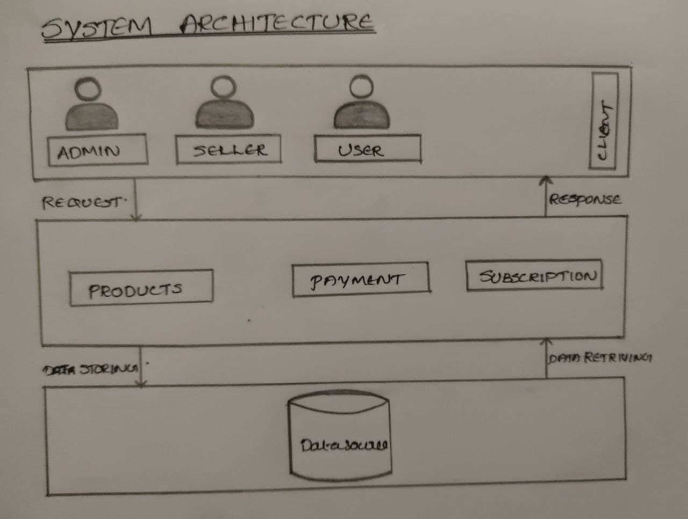
System Architecture

Slide 9
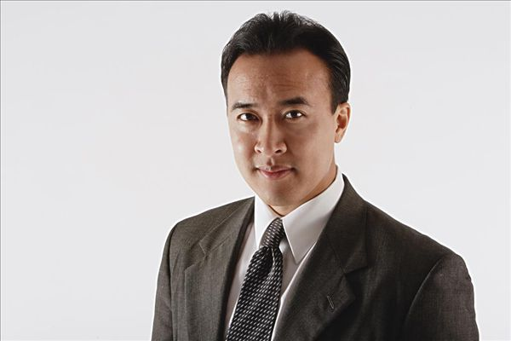


MODULES
Proposed system consists of mainly Three modules.
Admin – Website
Seller and User – Mobile App
ADMIN
SELLER
USER

Slide 10
1 . ADMIN
All activities in system is controlled by admin. The functions of admin is :
a. Login
b.View registered tutor and approve or reject tutor
i. View basic details of tutor
ii. Based on basic details approve tutor
iii. Based on basic details reject tutor
c. Exhibition management
i. Add details
ii. View details
iii. Edit details
iv. Delete details
v. View exhibition request from seller(candidate)
vi. Set winner for exhibition

Slide 11
d. Subscription package management
i. Add package details
ii. View package details
iii. Edit package details
iv. Delete package details
e. View users
i. View registered user
ii. View subscription users
f. View sellers and its products

Slide 12
2. SELLER
A registered seller can sell products. Typically one who teaches a single pupil or a very small group. The main function of the tutor is teaches the making of craft products.
a. Register
i. Upload basic details like name, age etc
b. Login
i. Approved tutor can only login to the site
c. View profile and update
d. Tutorial management
i. Upload video/documents
ii. View video/documents
iii. Delete video/documents
e. View doubts and send clarification
f. View rating

Slide 13
g.Products management
i. Add products
ii. View products
iii. Delete products
iv. Edit products
h.View booking
i.Apply for exhibition and view winners

Slide 14
3. USER
User can buy products and can access tutorials.
a.Register
b.Login
c.View profile
d.View tutors and tutorials
e.Buy subscription package and send payment
f.Payment Management
g.View exhibition
i.Buy products and add to cart
h.View seller
i.Buy products and add to cart
i.Rating
j.Send doubt and view reply.

Slide 15
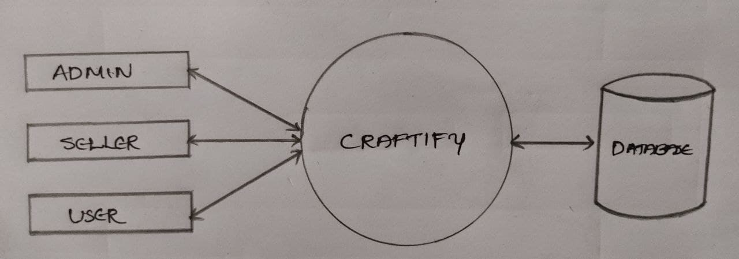
DFD
LEVEL 0

Slide 16
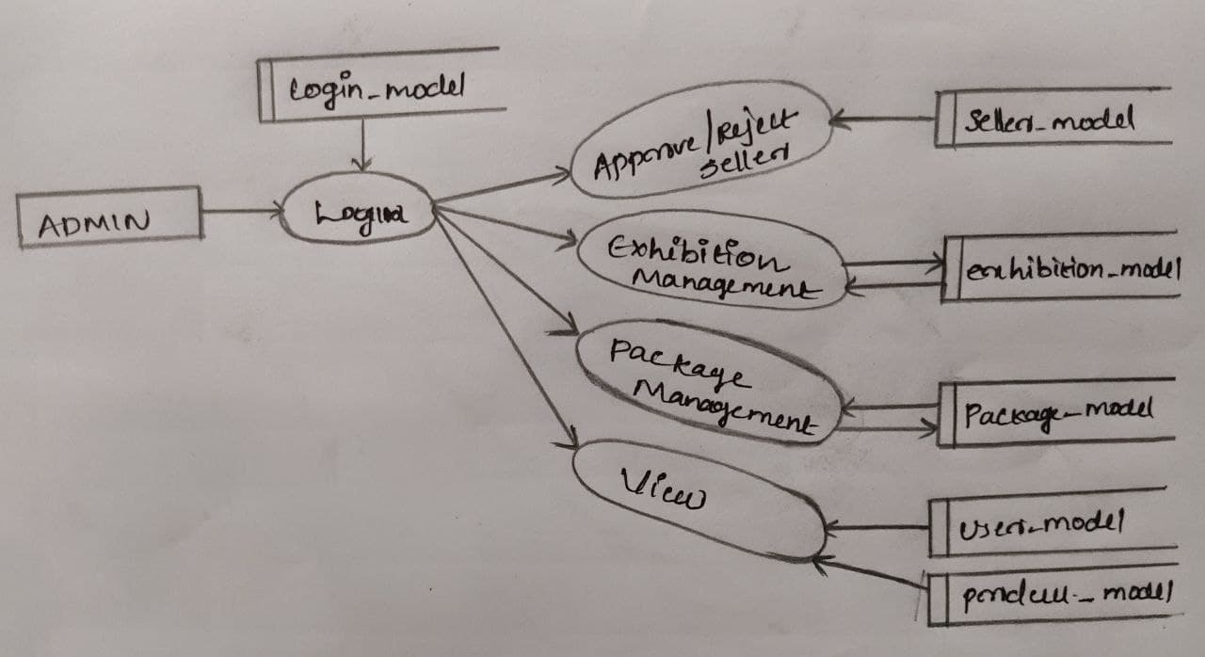
DFD
LEVEL 1

Slide 17
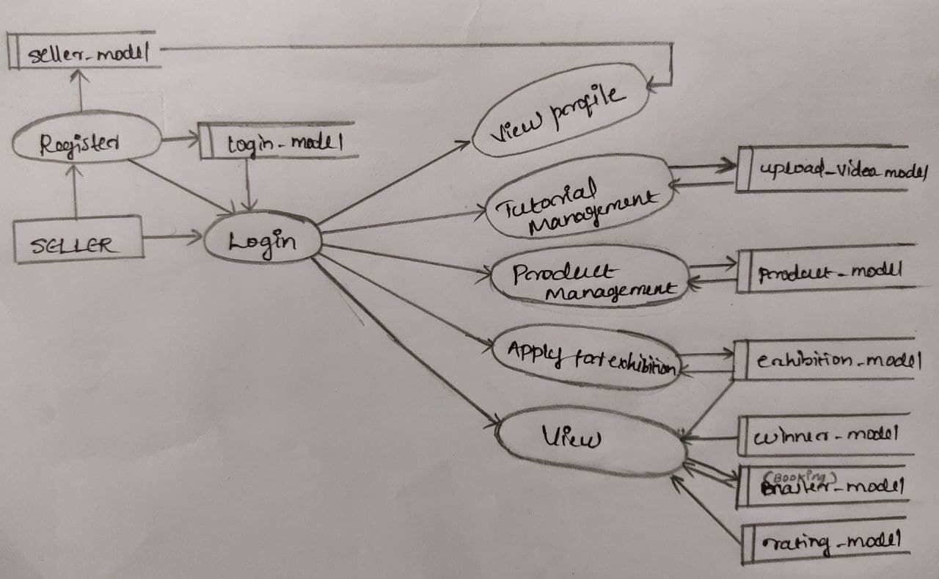
DFD
LEVEL 2

Slide 18
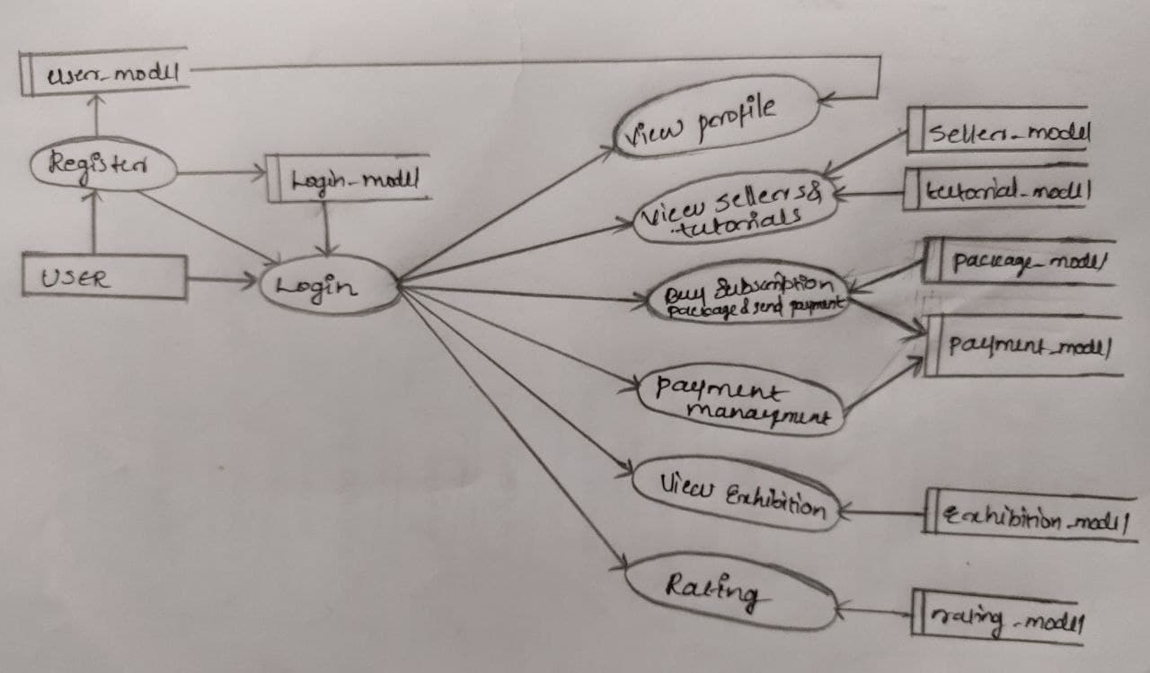
DFD
LEVEL 3

Slide 19
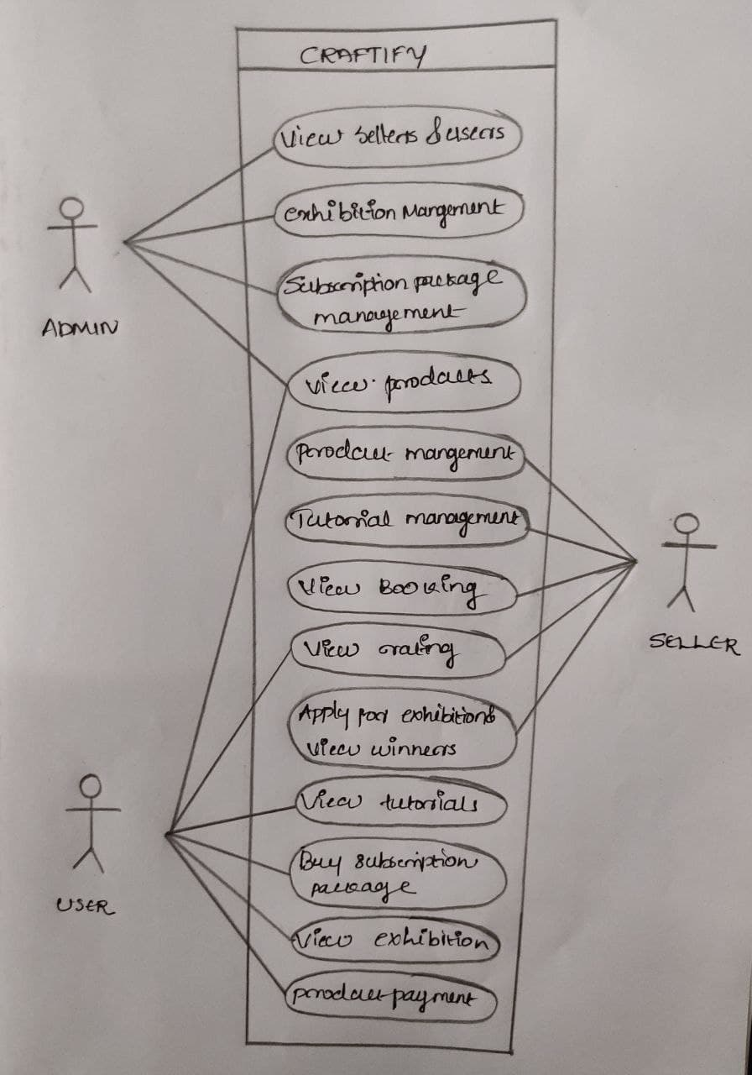
USECASE DIAGRAM

Slide 20
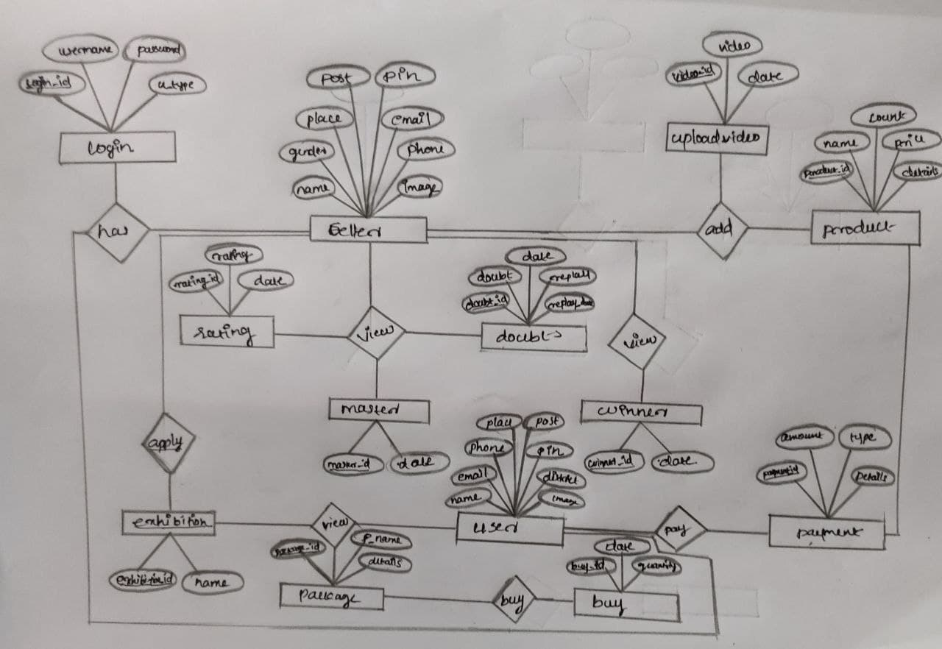
ER DIAGRAM

Slide 21
PROJECT PLAN
Topic Submission
Feb 14
0th Review
Feb 17
Final Review
May 12
1st Review
Project Guide Allocation
Feb1
2022
Feb
Mar
Apr
May
2022
Today
Topic Study
Feb17-Mar 7
Design
Mar 7-Mar 12
Coding
Mar 13- Apr 18
Testing
Apr 19- Apr 25
Implementation
Apr 25-May 4

Slide 22



THANK YOU

